Slide 1
belief in the after life meaning & concept
Mundane life is the preface of last life
This life is temporary and last life is eternal
This life is faulty and last life is perfect
All the results of worldly affairs don’t yield result but in the last life.
Man is created with a definite purpose.

Slide 2
Man,s life does not come to an end with his death. It continues after his demise also.
During the course of his life what ever he does is finished ,so far its material results are concerned, but its moral results still continue.
Everybody’s record is being maintained during his life period. It is very accurate record.
The day of judgement is the day of justice. No body will be wronged. His limbs will be his witness.

Slide 3
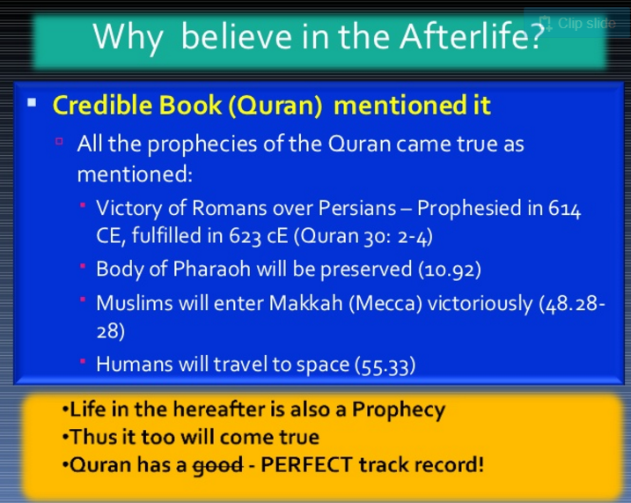

Slide 4
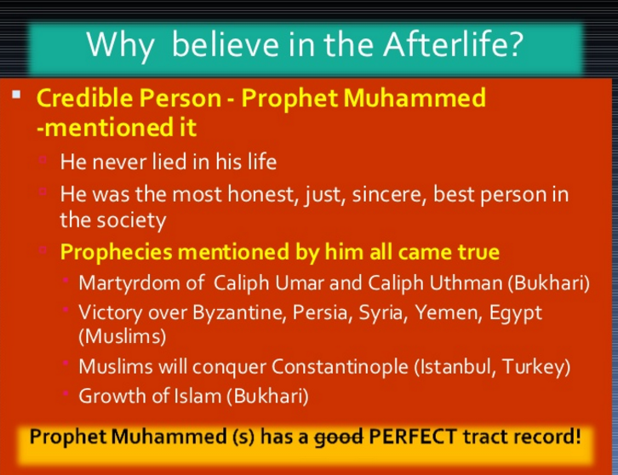

Slide 5
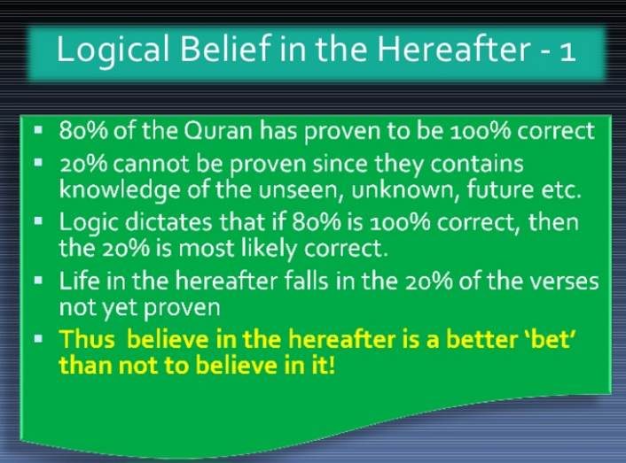

Slide 6
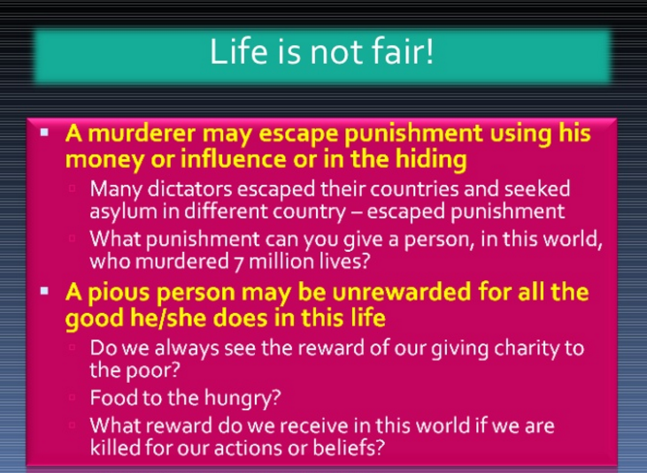

Slide 7
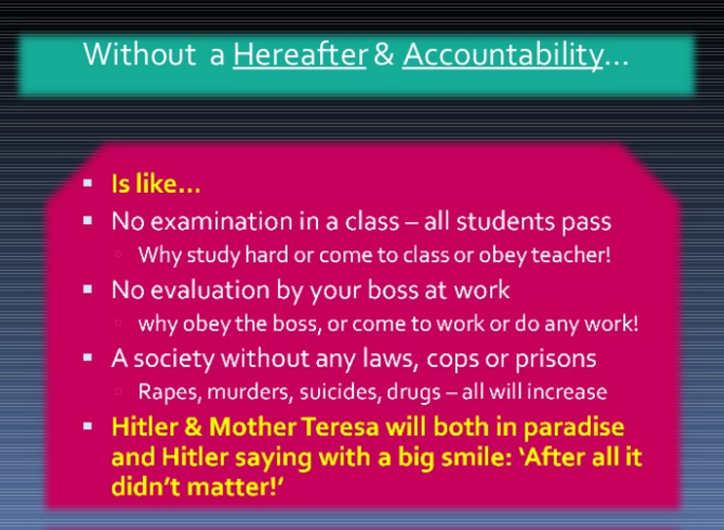

Slide 8
Different stages of Aakirat
Aalam-e-Barzakh (halting period)
Yom-e- infaakh fissor ( day of trumpet blowing)
Youmul baas (Life after death)
YAUM-UL-HASHR : (Day of Resurrection)
Yomul meezan: (Scale of justice fixing day)
YAUM-UL-JAZA / Yomud din: (Day of result/ award)
Now Aakhirat starts here:

Slide 9
Quranic concept of aakirat
اَلْقَارِعَةُ
مَا الْقَارِعَةُ
وَمَآ اَدْرٰىكَ مَا الْقَارِعَةُ
The Great Calamity; What a Great Calamity! And what should make thee know what the Great Calamity is? The day when men will be like scattered moths; And mountains will be like carded wool; Then as for him whose scales are heavy, He will have a pleasant life. But as for him whose scales are light, He will have hell as his resort.

Slide 10

Quranic teachings about Aakhirat
أَيْنَمَا تَكُونُوا يُدْرِككُّمُ الْمَوْتُ وَلَوْ كُنتُمْ فِي بُرُوجٍ مُّشَيَّدَةٍ
وَمَا هٰذِهِ الْحَيٰوةُ الدُّنْيَآ اِلَّا لَهْوٌ وَّلَعِبٌ ۭ وَاِنَّ الدَّارَ الْاٰخِرَةَ لَھِىَ الْحَـيَوَانُ ۘ لَوْ كَانُوْا يَعْلَمُوْنَ
And the life of world is nothing but a sport and play; the home of hereafter that is life, if they but knew
وَنُفِخَ فِي الصُّوْرِ فَصَعِقَ مَنْ فِي السَّمٰوٰتِ وَمَنْ فِي الْاَرْضِ اِلَّا مَنْ شَاۗءَ اللّٰهُ ۭ ثُمَّ نُفِخَ فِيْهِ اُخْرٰى فَاِذَا هُمْ قِيَامٌ يَّنْظُرُوْنَ
“And the Trumpet will be blown, and all who are in the heavens and all who are on the earth will swoon away, except him whom God wills.” (Quran 39:68)
وَنُفِخَ فِي الصُّوْرِ فَاِذَا هُمْ مِّنَ الْاَجْدَاثِ اِلٰى رَبِّهِمْ يَنْسِلُوْنَ
“And the Trumpet will be blown (i.e. the second blowing) and behold! From the graves they will come out quickly to their Lord.” (Quran 36:51)
يَوْمَ تُبَدَّلُ ٱلْأَرْضُ غَيْرَ ٱلْأَرْضِ وَٱلسَّمَـٰوَٰتُ وَبَرَزُوا۟ لِلَّهِ ٱلْوَٰحِدِ ٱلْقَهَّارِ
when the earth shall be changed into another earth, as shall be the heavens and when [all men] shall appear before God

Slide 11
cont
كَما بَدَأنا أَوَّلَ خَلقٍ نُعيدُهُ
“As we began the first creation, we shall repeat it (21-104)
قُلْ إِنَّ الْأَوَّلِينَ وَالْآخِرِينَلَمَجْمُوعُونَ إِلَىٰ مِيقَاتِ يَوْمٍ مَّعْلُومٍ
زَعَمَ الَّذِينَ كَفَرُوا أَن لَّن يُبْعَثُوا ۚ قُلْ بَلَىٰ وَرَبِّي لَتُبْعَثُنَّ ثُمَّ لَتُنَبَّؤُنَّ بِمَا عَمِلْتُمْ ۚ وَذَٰلِكَ عَلَى اللَّهِ يَسِيرٌ ٘

Slide 12
إِذَا الشَّمْسُ كُوِّرَتْ ٘
وَإِذَا النُّجُومُ انكَدَرَتْ ٘
وَإِذَا الْجِبَالُ سُيِّرَتْ ٘
وَإِذَا الْبِحَارُ سُجِّرَتْ ٘
وَإِذَا الْبِحَارُ فُجِّرَتْ ٘

Slide 13
How Earth will meet its ultimate end
This is not the prognostication of religious fanatics or sci-fi (speculative fiction) enthusiasts. No, this forecast is based on the rock-solid laws of physics.
In one or two billion years, the sun will become so hot that Earth’s oceans will boil away.
A few billion years after that, the sun will transform into a red giant, completely engulfing Mercury and Venus. Earth might escape that fate, but it still will be burnt to a crisp.
Then, after 10²⁶ (100 trillion trillion) years, the sun’s black dwarf corpse will finally devour Earth’s remnant ashes:
(it would be our ultimate end.)

Slide 14
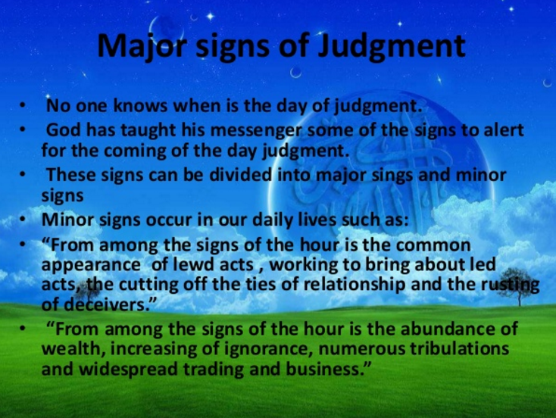

Slide 15
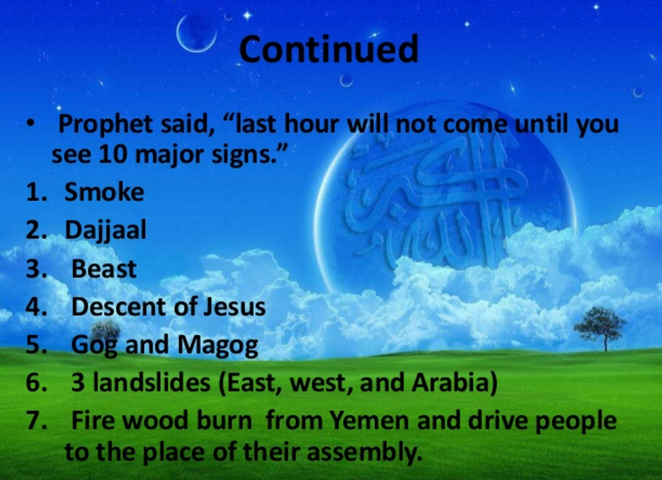

Slide 16
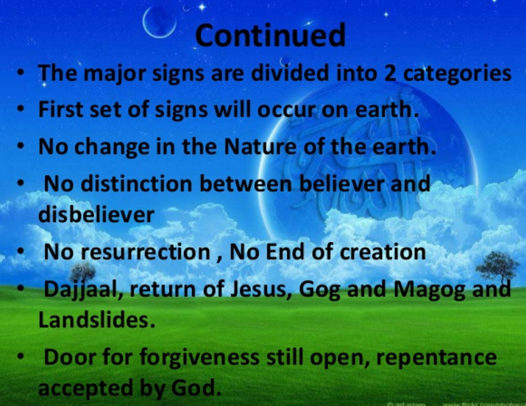

Slide 17
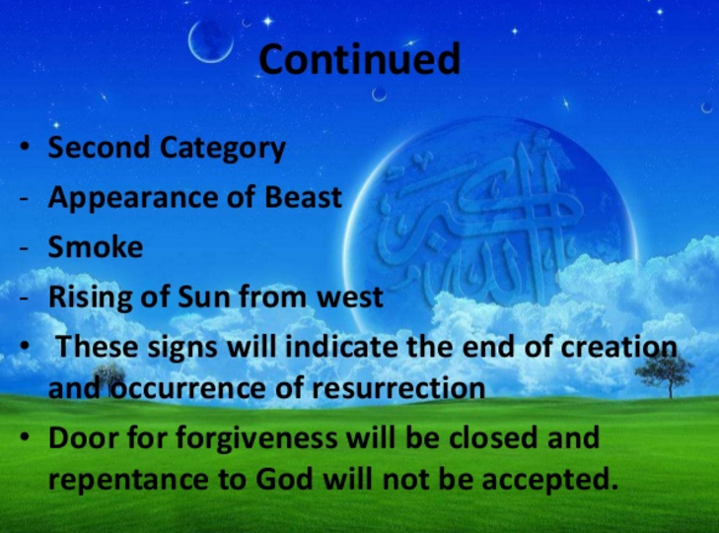

Slide 18
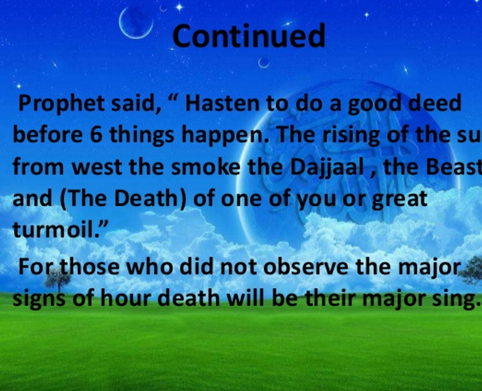

Slide 19
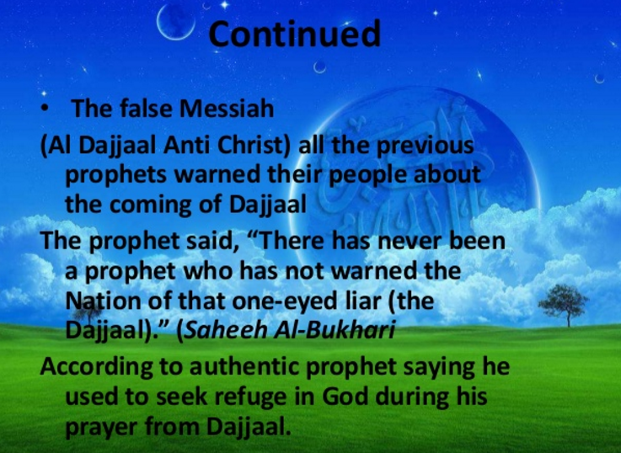

Slide 20
Influence of aakhirat on human life
Love for virtue and hatred from vice
Ready to face hardships
Fearlessness
Patience and forbearance
Expenditure in the way of Allah
Sense of responsibility
Purity of heart and sincerity of deeds

